Slide 1


CIFAR-10 Neural Networks

Slide 2
CIFAR-10 Dataset Overview
60,000 Images
32 x 32 pixels
3 RGB values
10 Classes

Slide 3
Data Preparation
Data Split:
Split into training, test, and validation datasets.
Validation Rationale
Provides an unbiased evaluation of the network.
Used to help tune the network.
40,000 images in training set
10,000 images in test set
10,000 images in validation set

Slide 4
Methodology
ANN
Serves as baseline for comparison
CNN
10 epochs > 100 epochs
Increasing convolutional layers
Optimisation
Metric: Accuracy

Slide 5

Neural Networks

Slide 6
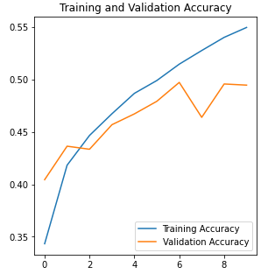
ANN
3 Layers
30,000 nodes
1000 nodes
10 nodes
10 Epochs
50% Validation Accuracy
55% Training Accuracy

Slide 7
VGG Architecture
Used for CNN models in the project
3x3 filters – number of filters increase after each layer/block
Stack of convulational layers
Followed by max pooling layer
Final layers converts images to categories
Softmax function converts numerical values into probability values

Slide 8
CNN – First Model
Only 1 convolutional layer
Activation Function: ReLU
Optimiser: Adam
Loss Function: Sparse categorical cross entropy
Padding: Same

Slide 9
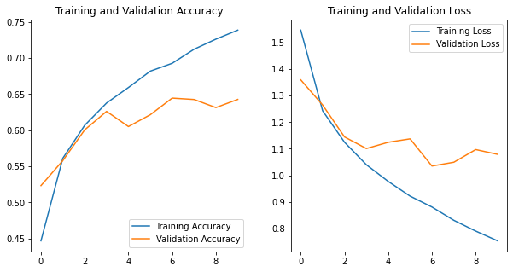
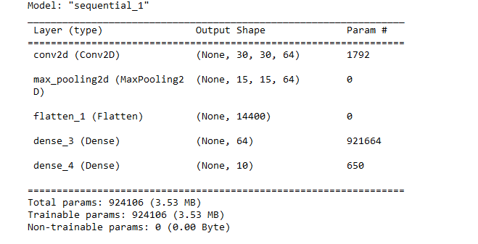
CNN – First Model Results
10 epochs
Accuracy: 64%
Over 900k total parameters

Slide 10
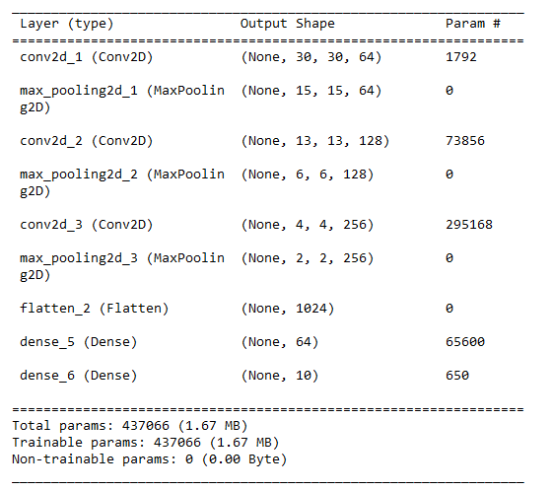
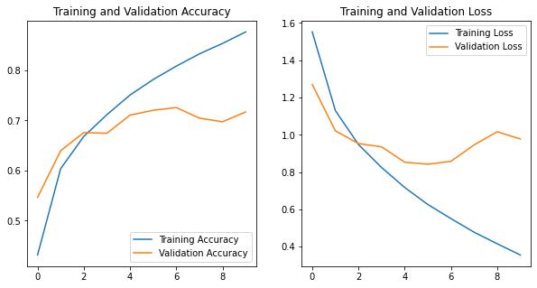
CNN – Second Model
Three convolutional layers with 32, 64, and 128 filters respectively
Same hyperparameters as first model
10 epochs
71% validation accuracy
430k parameters

Slide 11
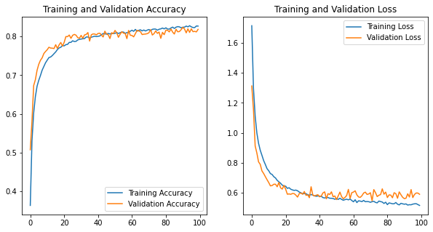
Improving the model - Dropout
100 epochs
Dropout after each block/layer – increasing by 10% each time
82% accuracy

Slide 12
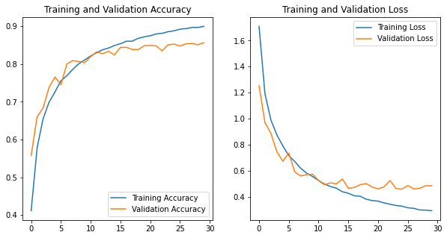
Improving the model – Batch normalisation
Improves efficiency, reliability, and stabilises
Early stop introduced to avoid overfitting
85% accuracy – improvement of further 3%

Slide 13
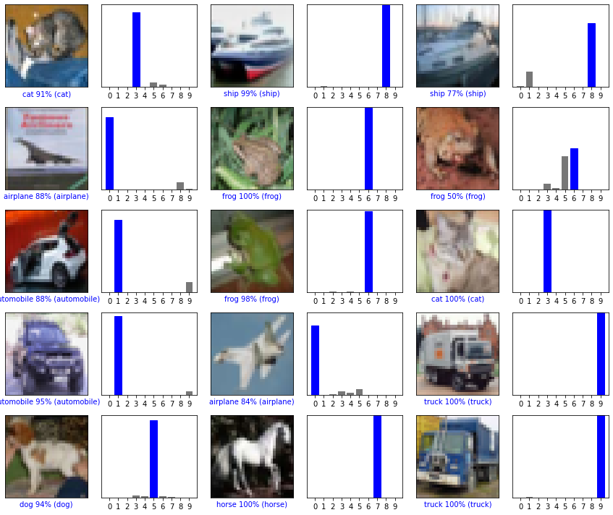
Model Evaluation

Slide 14
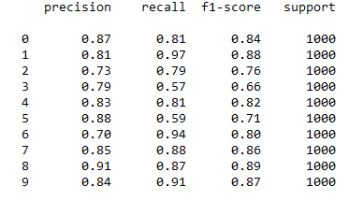
Class metrics

Slide 15
Conclusion
CNN more suited to image classification
VGG architecture efficient and effective
Tweaking models for improvements most interesting
Model can be improved given more resources/computational power.

Slide 16
References
Boesch, G. (2023) VGG very deep convolutional networks (vggnet) - what you need to know, viso.ai. Available at: https://viso.ai/deep-learning/vgg-very-deep-convolutional-networks/ (Accessed: 12 October 2023).
Brahmane, A. (2020) Deep learning with CIFAR-10 image classification, Medium. Available at: https://towardsdatascience.com/deep-learning-with-cifar-10-image-classification-64ab92110d79 (Accessed: 12 October 2023).
Brownlee, J. (2020) How to develop a CNN from scratch for CIFAR-10 photo classification, MachineLearningMastery.com. Available at: https://machinelearningmastery.com/how-to-develop-a-cnn-from-scratch-for-cifar-10-photo-classification/ (Accessed: 12 October 2023).
Codebasics (2020) Image classification using CNN (CIFAR10 dataset) | deep learning tutorial 24 (Tensorflow & Python), YouTube. Available at: https://www.youtube.com/watch?v=7HPwo4wnJeA (Accessed: 12 October 2023).
Franky (2022) Once upon a time in CIFAR-10, Medium. Available at: https://franky07724-57962.medium.com/once-upon-a-time-in-cifar-10-c26bb056b4ce (Accessed: 12 October 2023).
Gad, A.F. (2021) Accuracy, precision, and recall in deep learning, Paperspace Blog. Available at: https://blog.paperspace.com/deep-learning-metrics-precision-recall-accuracy/ (Accessed: 12 October 2023).
Gupta, A. (2023) A comprehensive guide on Optimizers in deep learning, Analytics Vidhya. Available at: https://www.analyticsvidhya.com/blog/2021/10/a-comprehensive-guide-on-deep-learning-optimizers/ (Accessed: 12 October 2023).
Hasan, F. (2023) Educative answers - trusted answers to developer questions, Educative. Available at: https://www.educative.io/answers/what-are-some-deep-details-about-pooling-layers-in-cnn (Accessed: 12 October 2023).
Johnson, M. (2022) Why is the VGG network commonly used?, nnart. Available at: https://nnart.org/why-is-vgg-commonly-used/ (Accessed: 12 October 2023).

Slide 17
References (cont.)
Mahendra, S. (2023) What is the adam optimizer and how is it used in machine learning, Artificial Intelligence +. Available at: https://www.aiplusinfo.com/blog/what-is-the-adam-optimizer-and-how-is-it-used-in-machine-learning/ (Accessed: 12 October 2023).
Mustafeez, A.Z. (2023) Educative answers - trusted answers to developer questions, Educative. Available at: https://www.educative.io/answers/what-is-early-stopping (Accessed: 12 October 2023).
Pramoditha, R. (2022) Why do we need a validation set in addition to training and test sets?, Medium. Available at: https://towardsdatascience.com/why-do-we-need-a-validation-set-in-addition-to-training-and-test-sets-5cf4a65550e0 (Accessed: 12 October 2023).
Rahman, M. (2023) What you need to know about sparse categorical cross entropy, Medium. Available at: https://rmoklesur.medium.com/what-you-need-to-know-about-sparse-categorical-cross-entropy-9f07497e3a6f (Accessed: 12 October 2023).
Shah, T. (2020) About train, validation and test sets in machine learning, Medium. Available at: https://towardsdatascience.com/train-validation-and-test-sets-72cb40cba9e7 (Accessed: 12 October 2023).
Sharma, P. (2023) CNN vs ann for image classification, Online Tutorials, Courses, and eBooks Library. Available at: https://www.tutorialspoint.com/cnn-vs-ann-for-image-classification (Accessed: 12 October 2023).
Sharma, S. (2022) Activation functions in neural networks, Medium. Available at: https://towardsdatascience.com/activation-functions-neural-networks-1cbd9f8d91d6 (Accessed: 12 October 2023).
Understanding VGG16: Concepts, architecture, and performance (2023) Datagen. Available at: https://datagen.tech/guides/computer-vision/vgg16/ (Accessed: 12 October 2023).
Vijay, U. (2020) Early stopping to avoid overfitting in neural network- Keras, Medium. Available at: https://medium.com/zero-equals-false/early-stopping-to-avoid-overfitting-in-neural-network-keras-b68c96ed05d9 (Accessed: 12 October 2023).
What is batch normalization (2022) Deepchecks. Available at: https://deepchecks.com/glossary/batch-normalization/ (Accessed: 12 October 2023).

